Slide 1

Deep learning In Artificial intelligence (AI) Part II
Prepared by Ts. Dr. Lee Sue Han

Slide 2
Agenda
Vision Transformer (ViT)
Contrastive Language–Image Pre-training (CLIP)

Slide 3
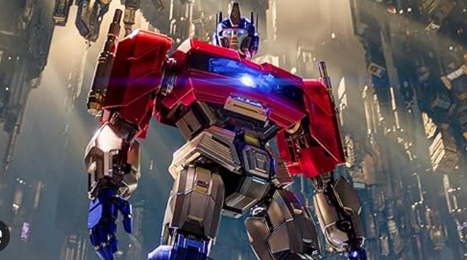
Before Vision Transformer, Lets Understand What is Transformer ☺

Slide 4
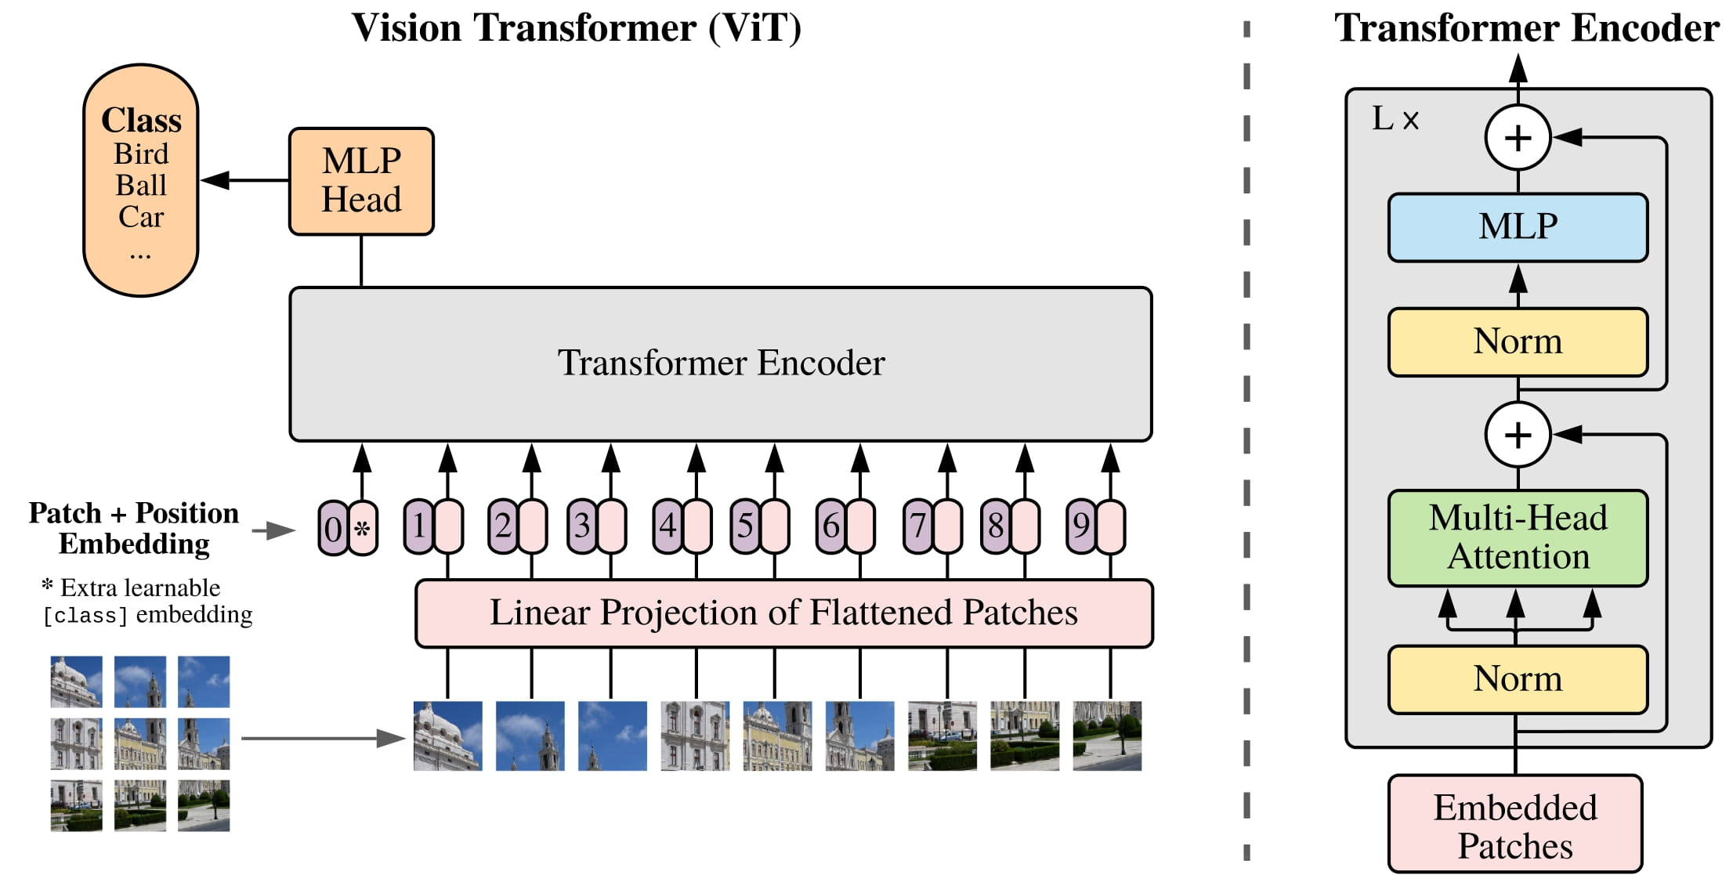
What Is Vision Transformer (ViT)?

Slide 5
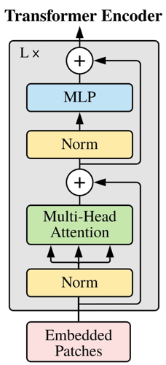

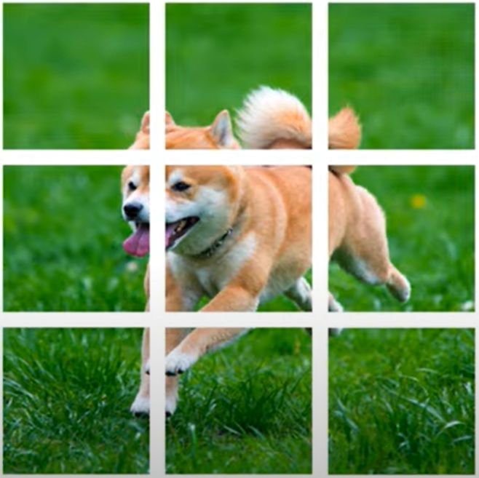
How ViT works?
1. Split images into patches
Patches can either overlap or not.

Slide 6
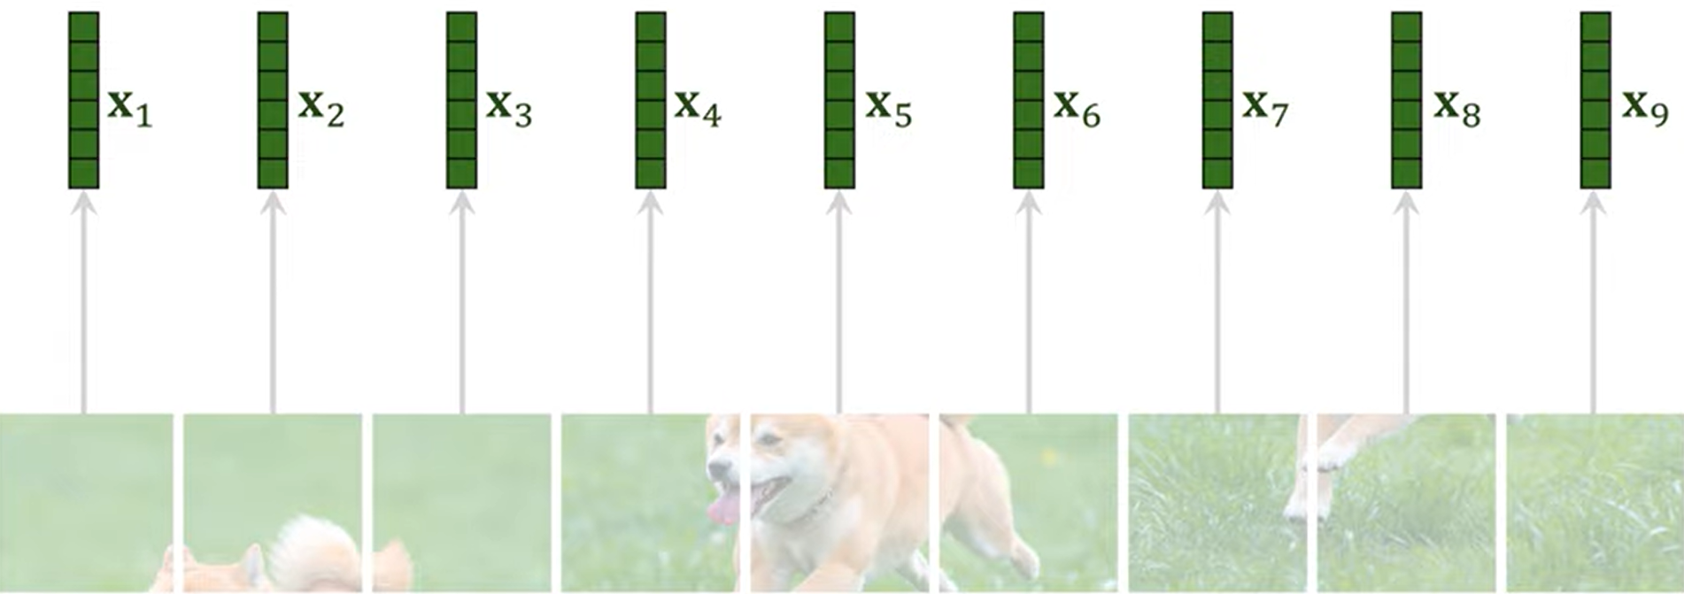
How ViT works?
2. Vectorization

Slide 7
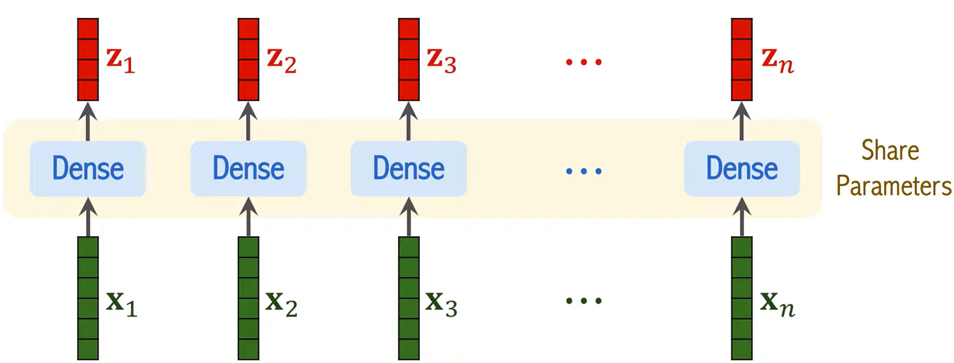
How ViT works?
3. Apply Linear Transformation (Dense layer)

Slide 8
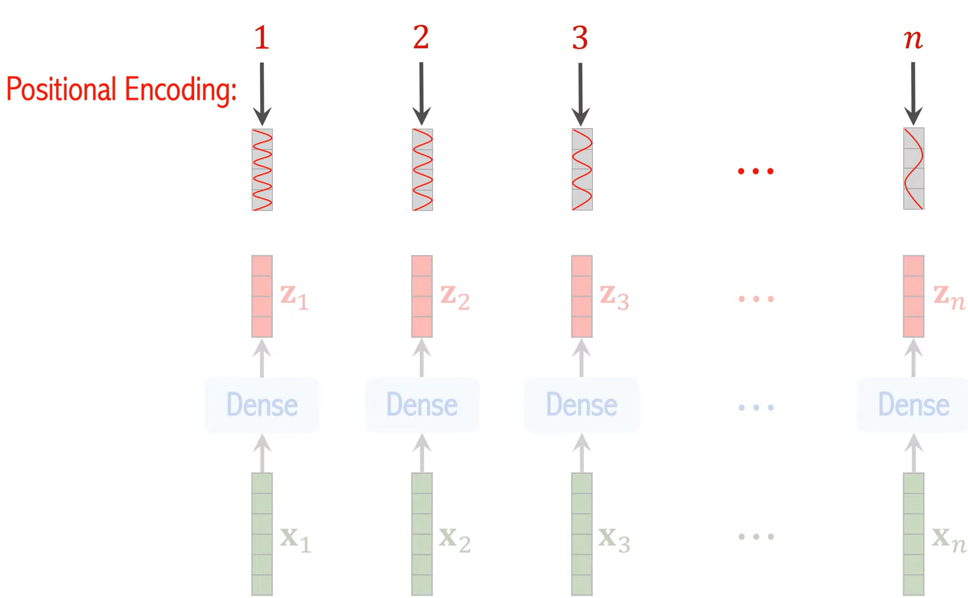
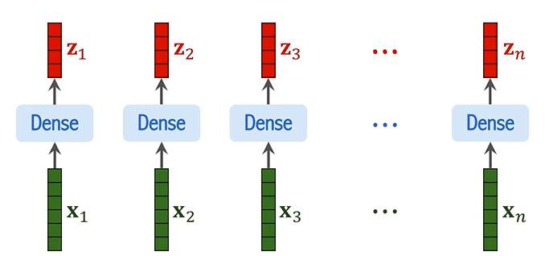
How ViT works?
4. Add Positional Encoding vectors to z₁, z₂, z₃,… z_{n}
Capture both the contents and the position of the patches

Slide 9
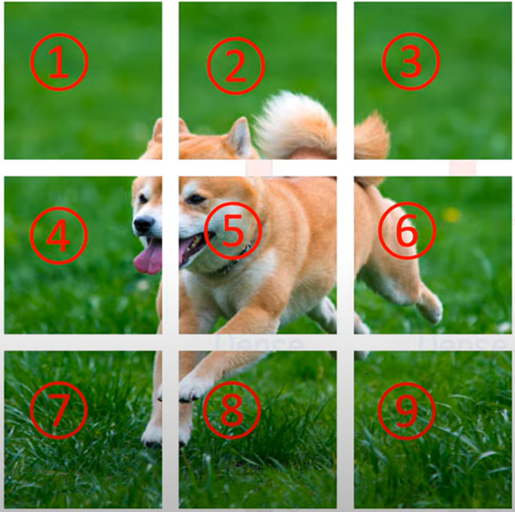
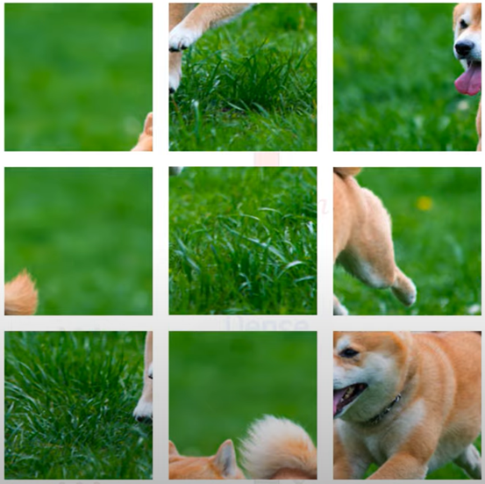
How ViT works?
Transformers lack an inherent sense of input order, so positional encoding is introduced to convey the position of each element in the sequence, ensuring the model understands the sequential structure.

Slide 10
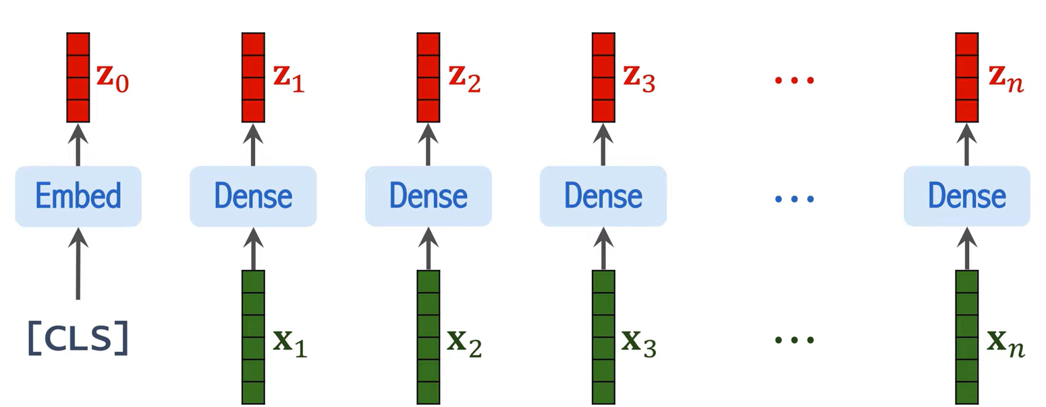
How ViT works?
5. Add CLS token
Acts as a representative for the entire image

Slide 11
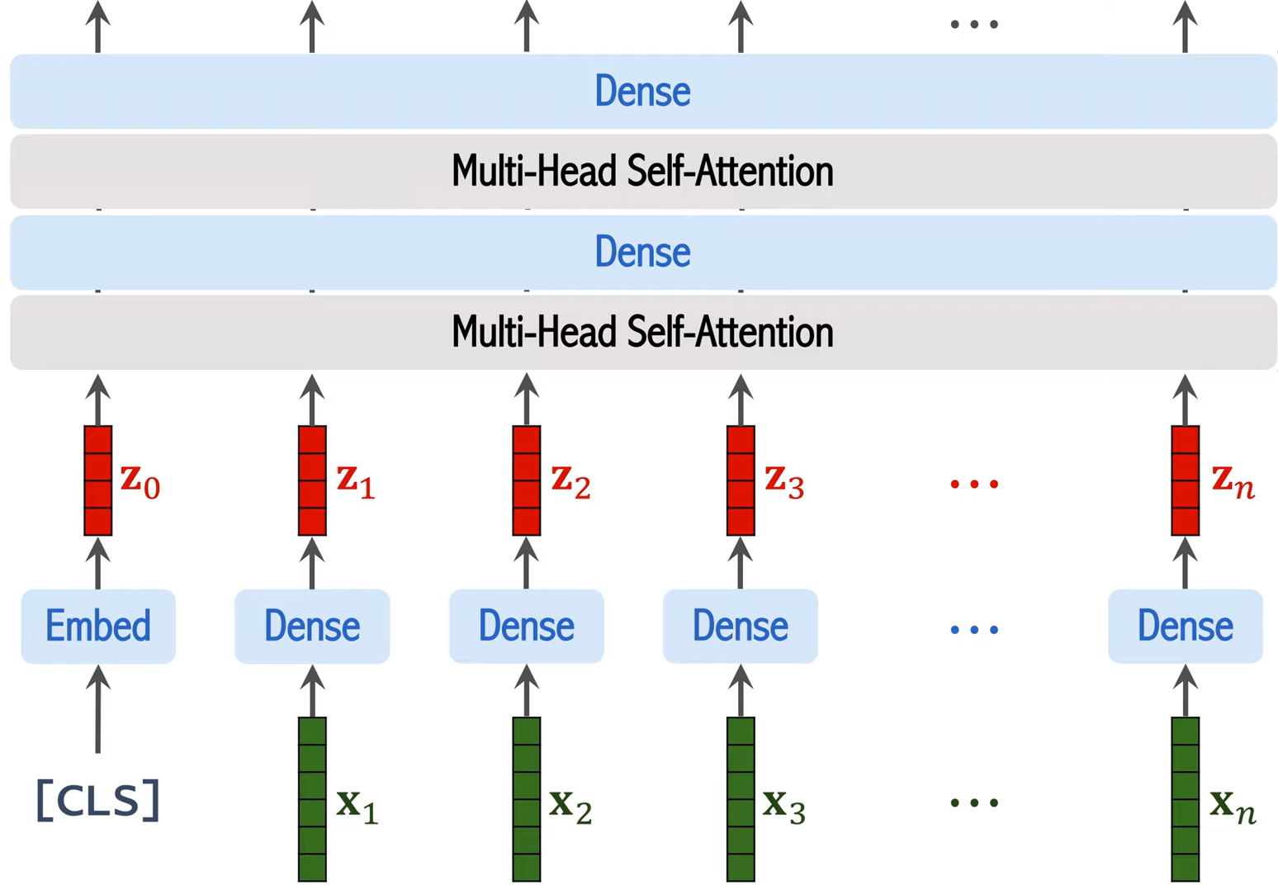
How ViT works?
6. Go through Transformer Encoder Network
Transformer Encoder Network

Slide 12
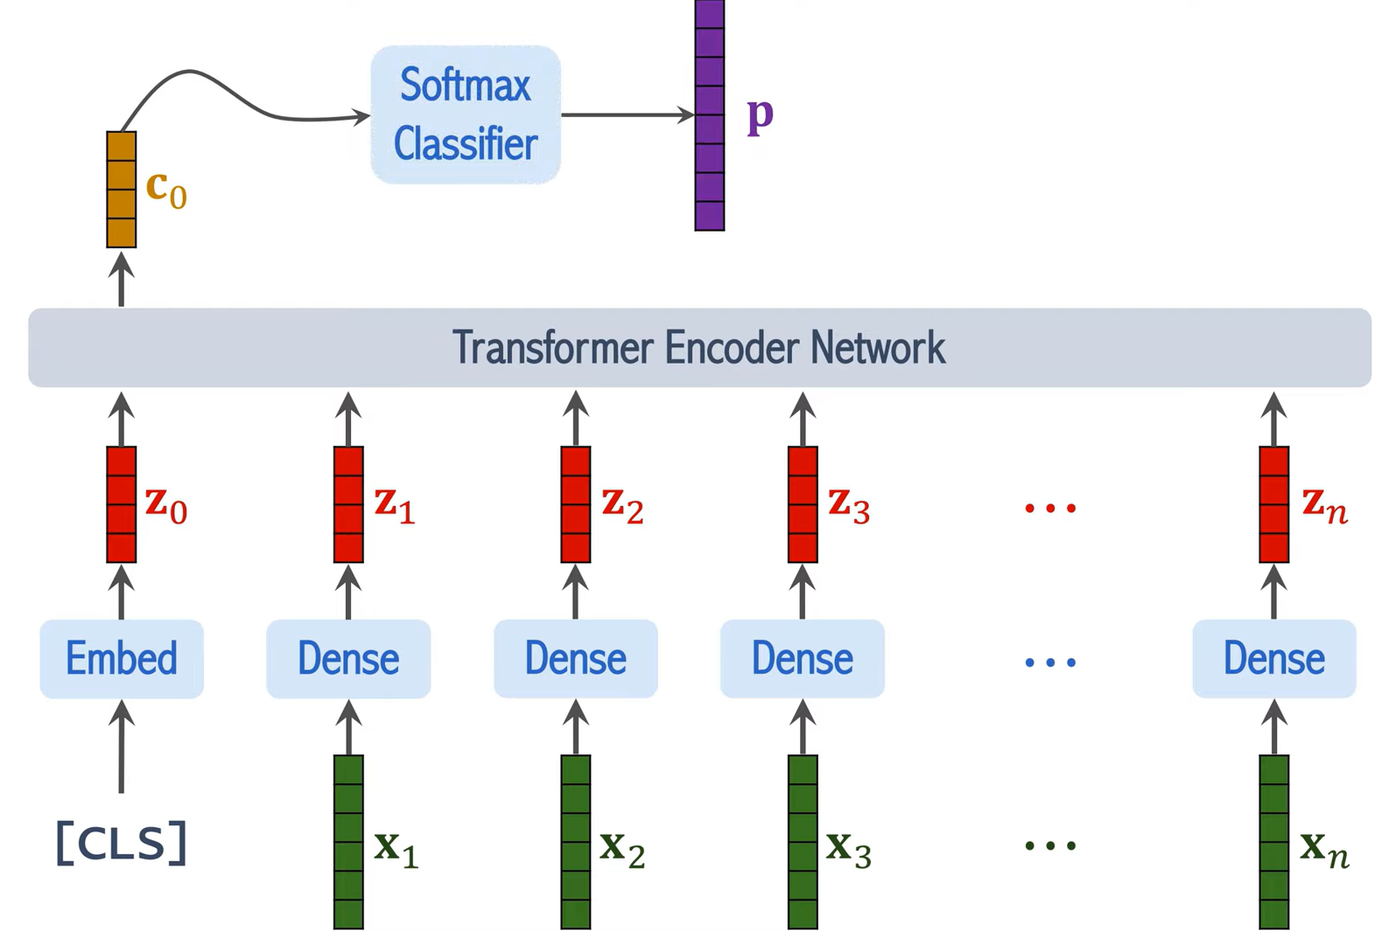
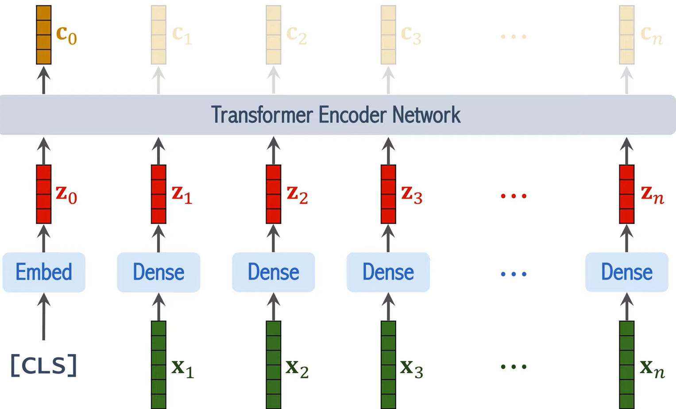
How ViT works?
7. Feed into classification layer
Ignore the output of c₁ to c_{n}
Classification based on only c₀

Slide 13
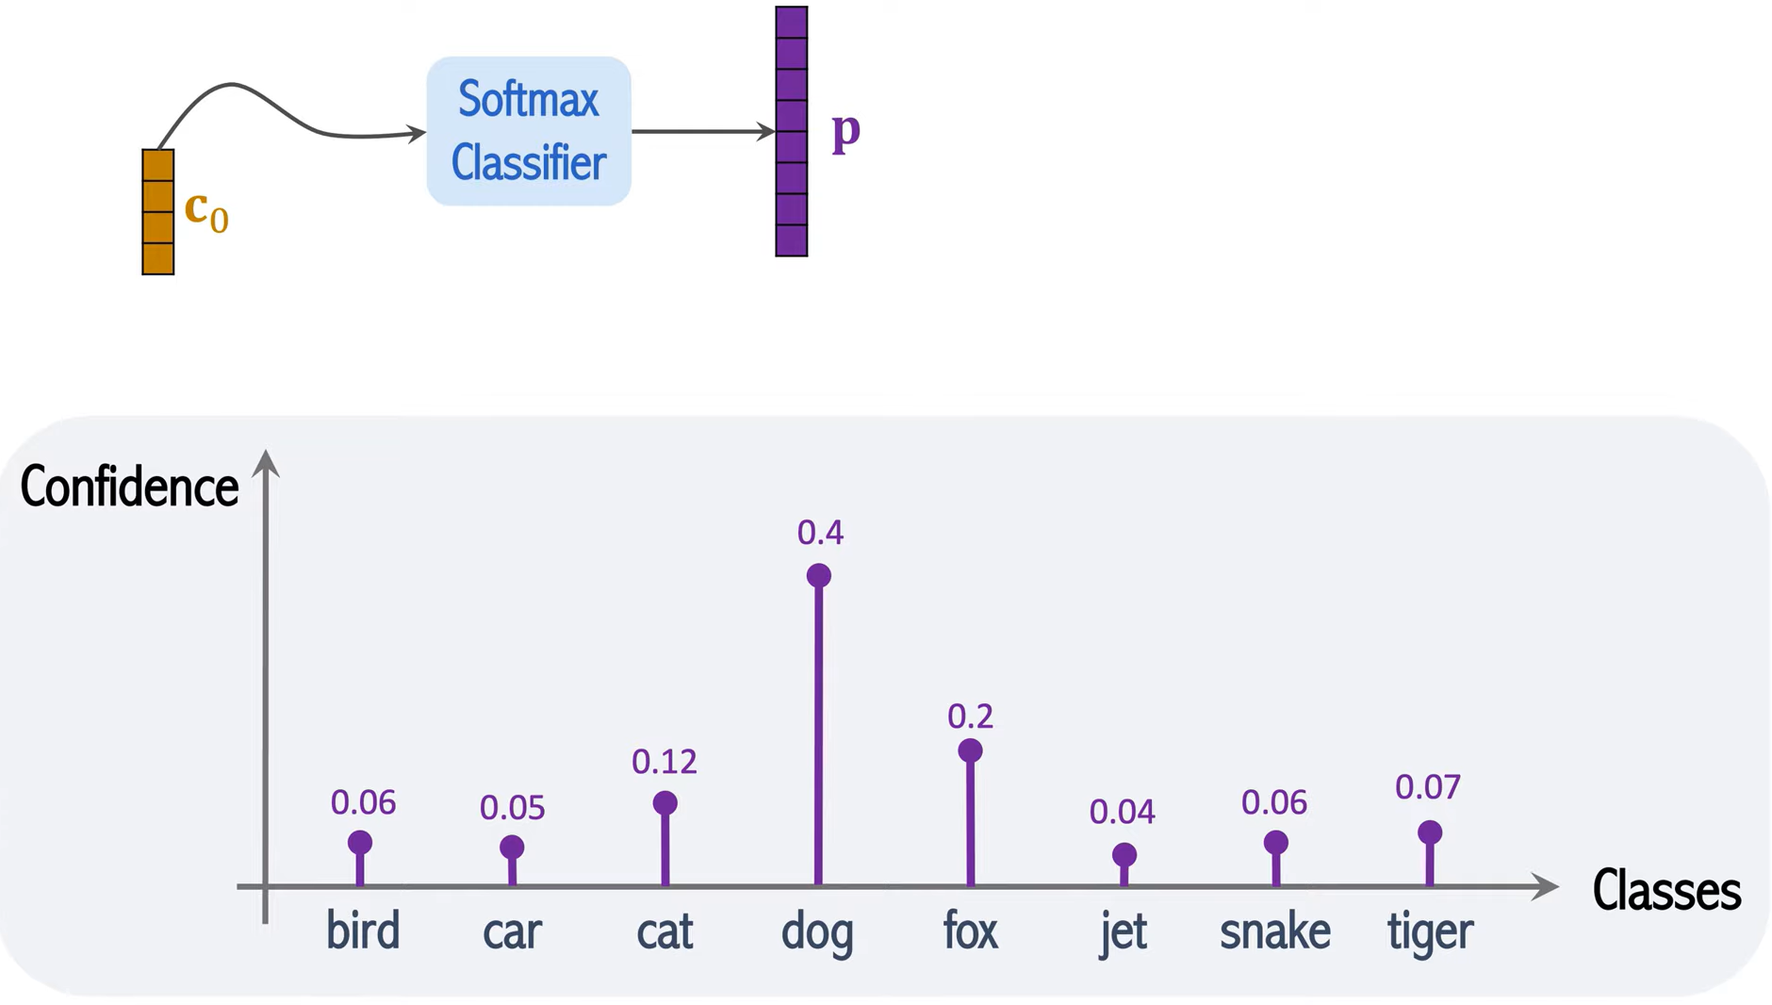
How ViT works?
8. Compute prediction output

Slide 14
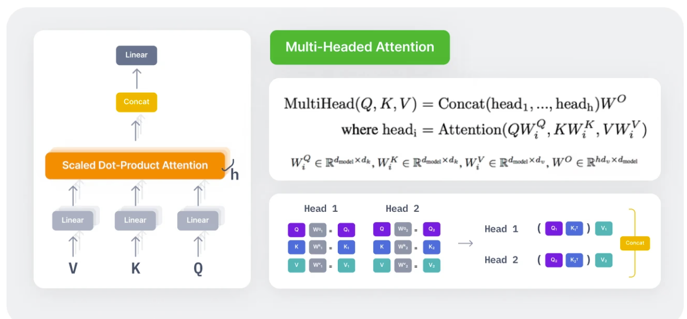
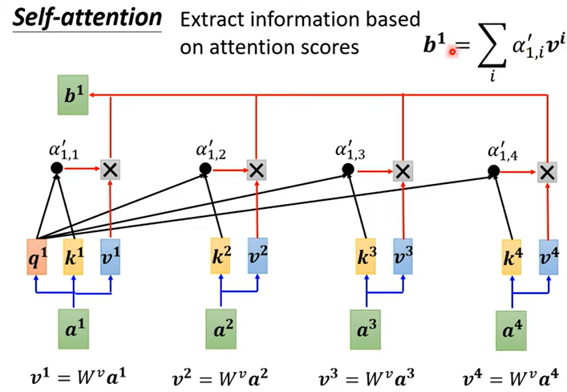
The Key Components of ViT
Self-Attention Mechanism: Central to the transformer is the self-attention mechanism, which evaluates the relationship between each element of the input and all other elements. This enables the model to assign varying importance to each element based on the context provided by the rest.
Multi-Head Attention: Building on self-attention, multi-head attention applies multiple attention layers in parallel, enabling the model to attend to different parts of the input simultaneously and capture a wider range of contextual information.
head₁
head₁

Slide 15
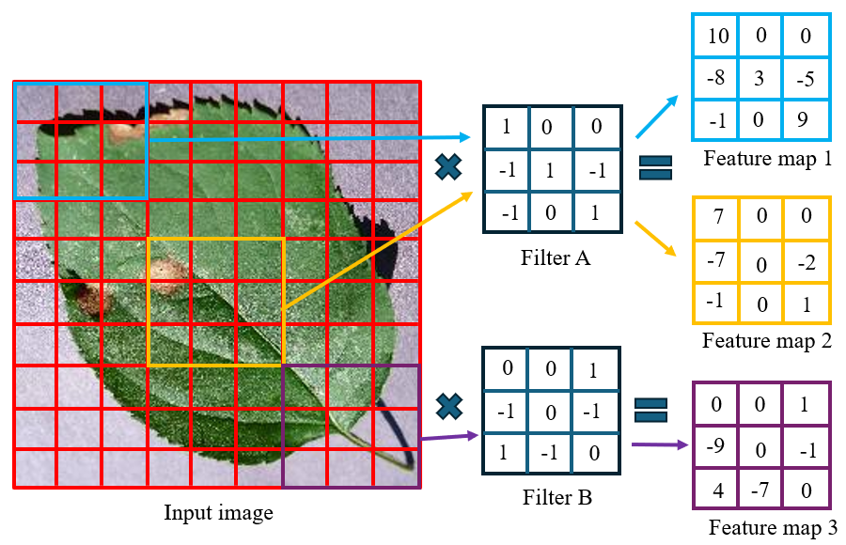
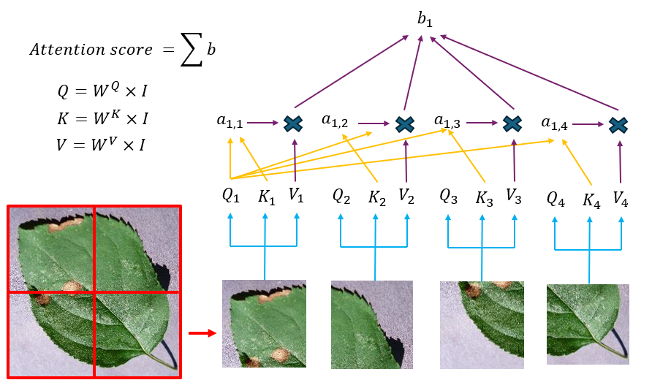
ViT Vs. CNN
Training dataset
CNN models >> ImageNet dataset (1.2m images)
ViT models >> JFT-300m dataset (300m images)
Convolutional layer
Transformer module
(1980 – present)
(2017 – present)

Slide 16
ViT Vs. CNN
Learned Features: Vision Transformers (ViTs) excel at capturing long-range dependencies more effectively than Convolutional Neural Networks (CNNs), thanks to the self-attention mechanism, which simultaneously considers all patches.
Flexibility: ViTs offer high flexibility, making them adaptable to varying image resolutions and patch sizes.
Scalability: ViTs scale efficiently with larger model sizes and training datasets, often surpassing CNNs in performance on extensive datasets.
Computational Efficiency: While CNNs are more lightweight and computationally efficient, ViTs require longer training times to achieve optimal results.
Application History: CNNs have a long-standing history of successful applications, particularly excelling in tasks like image classification.

Slide 17
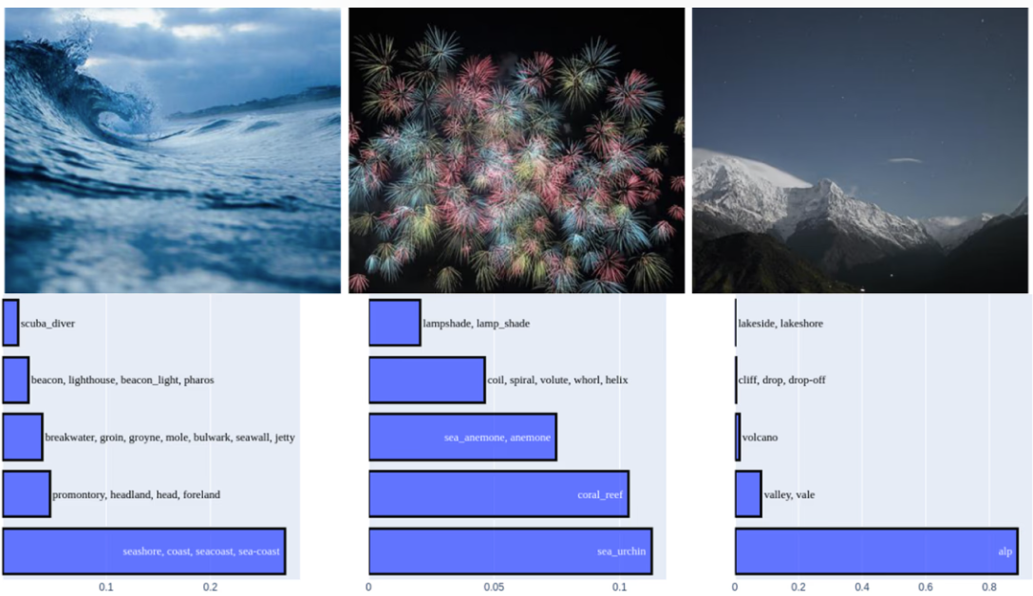
Applications of ViT
Image Classification

Slide 18
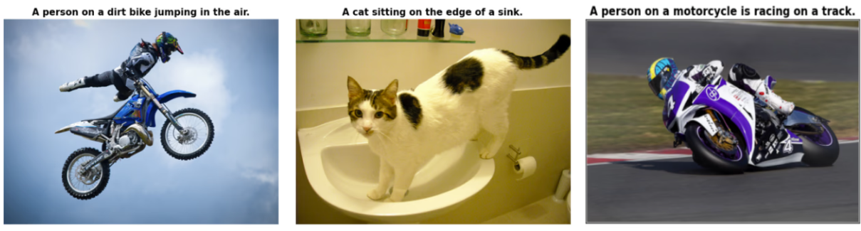
Applications of ViT
Image Captioning

Slide 19
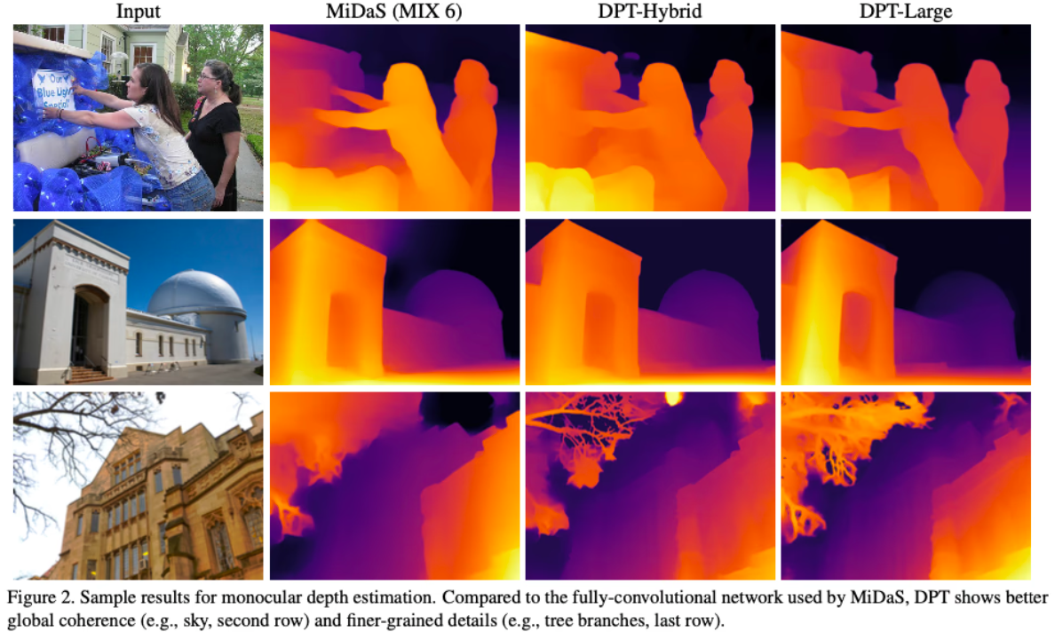
Applications of ViT
Image Segmentation

Slide 20
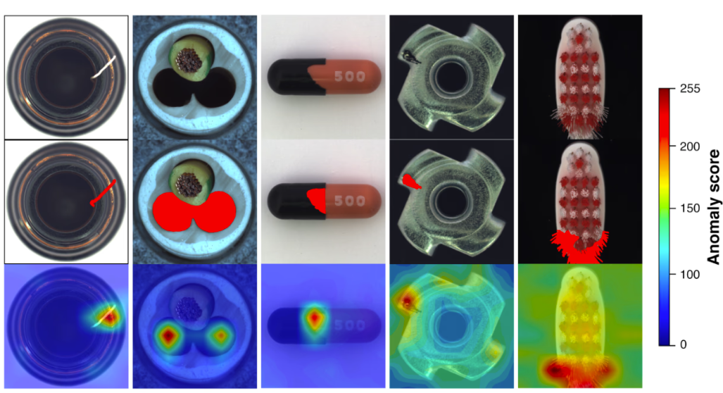
Applications of ViT
Anomaly Detection

Slide 21
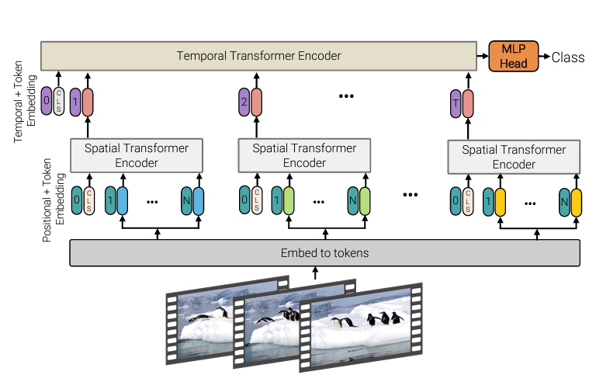
Applications of ViT
Action Recognition

Slide 22
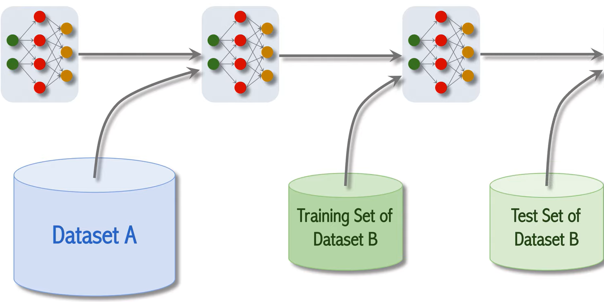
Learning Materials 1 (ViT_model_training.ipynb)
Randomly Initialized
Pretrained
Finetuned
Test Accuracy

Slide 23
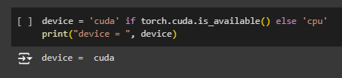
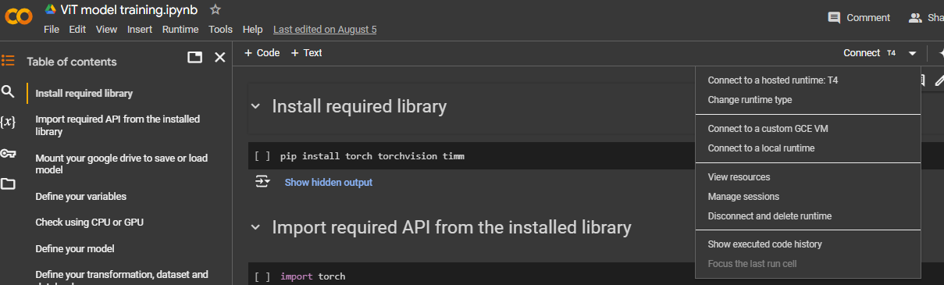
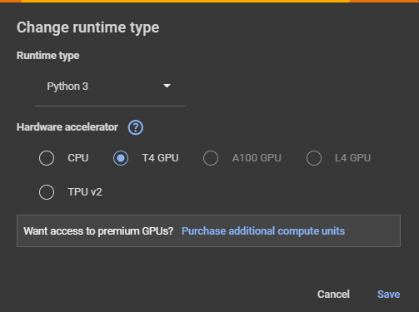
Learning Material 2 (ViT_model_training.ipynb)
Go to google colab website
https://colab.research.google.com/
Download demo scripts from canvas and load to your google collab.
ViT_model_training.ipynb
CLIP_model_training.ipynb

Slide 24
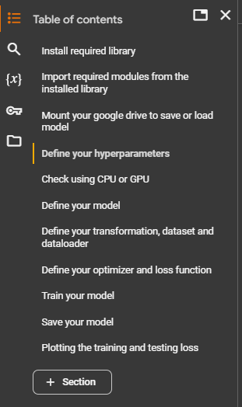
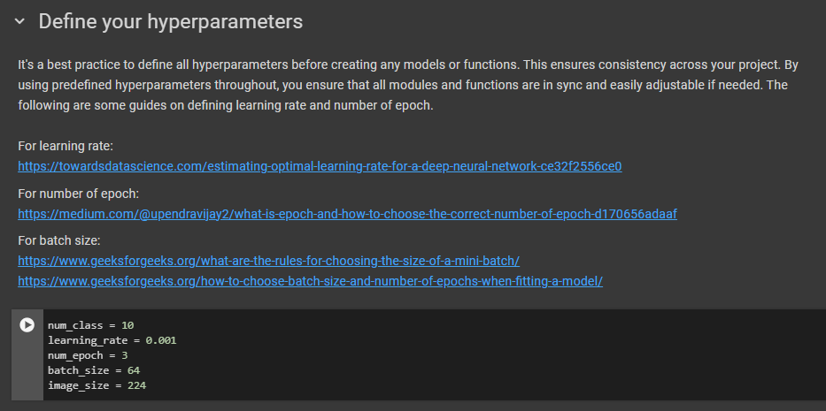
Learning Material 2 (ViT_model_training.ipynb)

Slide 25
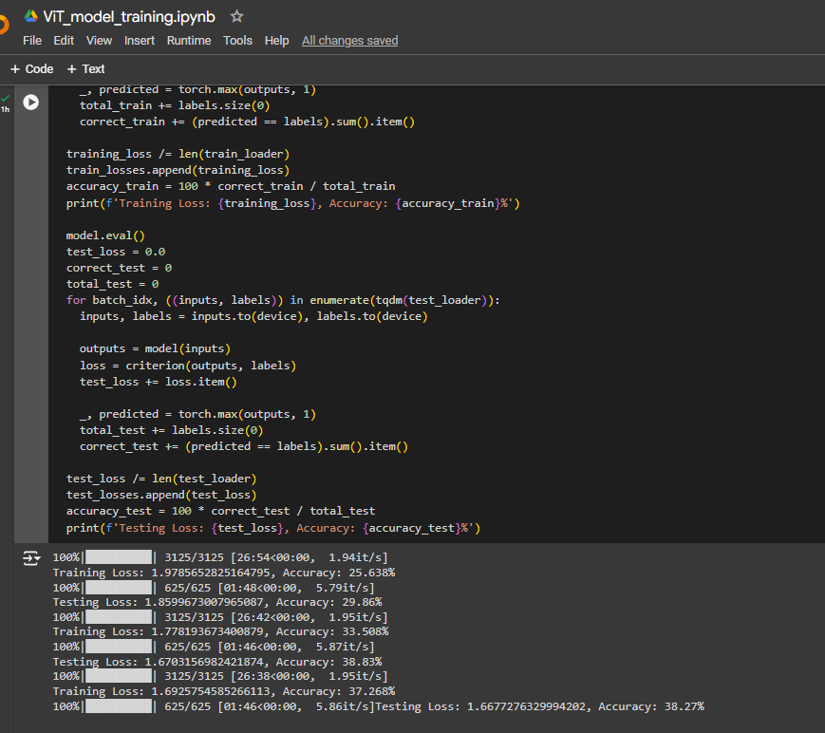
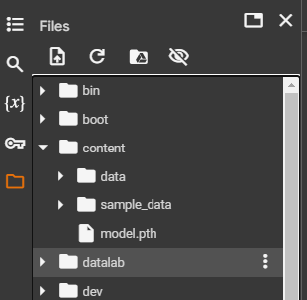
Learning Material 2 (ViT_model_training.ipynb)

Slide 26
Agenda
Vision Transformer (ViT)
Contrastive Language–Image Pre-training (CLIP)

Slide 27
What is CLIP?
CLIP stands for Contrastive Language–Image Pre-training.
It is a network that can be directly used for image classification.
It is suitable for zero-shot learning. This network does not require fine-tuning when predicting labels on new images.
The classification accuracy is more robust across a wide range of image datasets.
This is crucial for real-world deployment.

Slide 28
Contrastive Language-Image Pre-Training (CLIP) model
Image input
Image model
similarity
text input
Language model
CLIP model

Slide 29
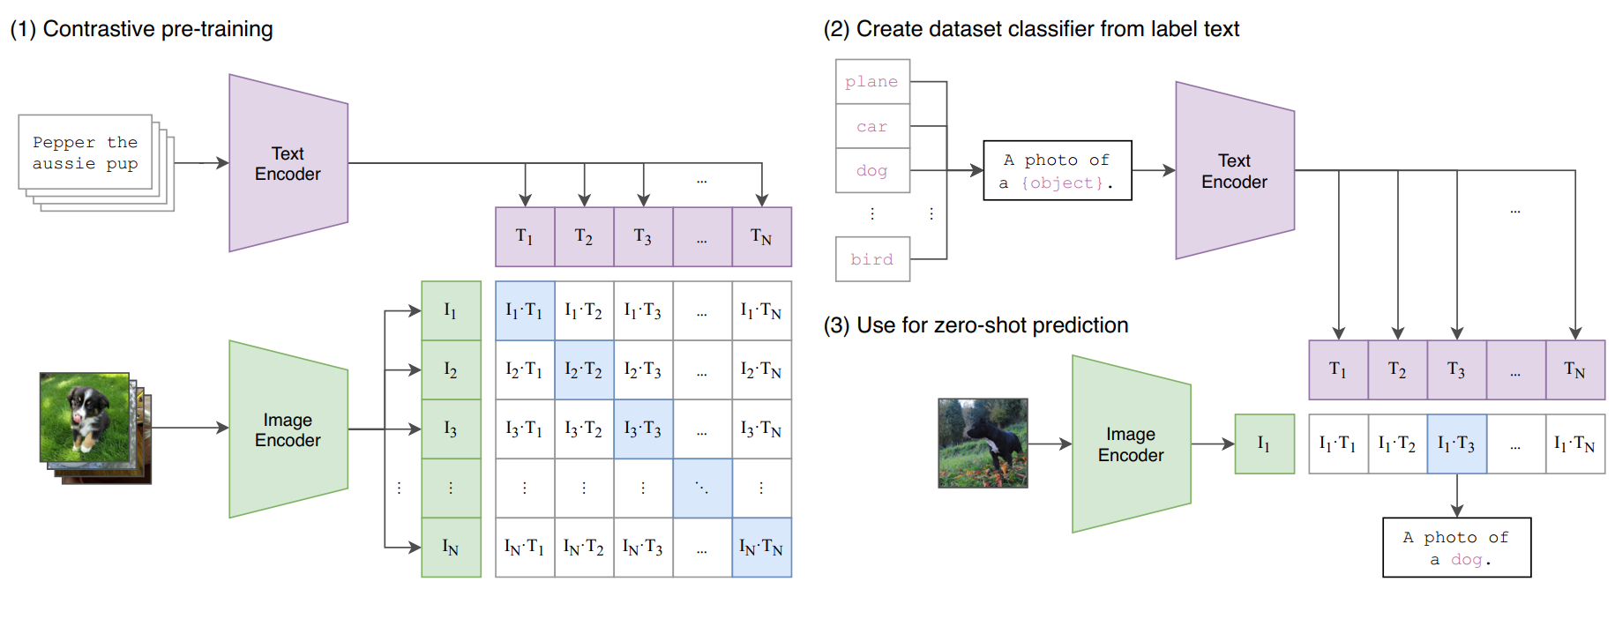
How CLIP was Trained?

Slide 30
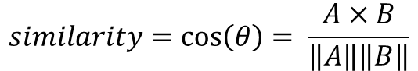
CLIP Model Training
The text encoder is a standard transformer encoder. The extracted feature is the embedding of the CLS token.
The image encoder is either a ResNet-50 or a Vision Transformer (ViT).
CLIP was trained using a dataset of 400 million image-text pairs collected from the internet
Each image is paired with text description or captions
Use cosine similarity loss
$$similarity=\cos\left(θ\right)= \frac{A×B}{\left\|A\right\|\left\|B\right\|}$$

Slide 31



Contrastive Pre-Training of Language-Image Pairs
Image data
Text data 1
Text data 2
Text data 3
Dog, cat
There is a dog and a cat in the image
A dog is on left side while a cat is on the right side
Dog, cat
There is a dog and a cat in the image
A cat is pointing on a dog
basketball
There is a basketball in the image
A basketball is on the top left of the image

Slide 32
Testing Phase
Text Encoder: During inference, CLIP’s text encoder generates embeddings for class names or descriptions, like "dog," "cat," or "car."
On-the-Fly Classifier: By embedding class labels, CLIP creates a linear classifier, comparing image embeddings to class label embeddings to classify images.

Slide 33
Benefits of CLIP
No Fine-Tuning Required: CLIP doesn’t need retraining for each task; providing relevant labels is sufficient for effective classification based on learned relationships.
Flexible Classification: Easily switch labels without retraining; CLIP can classify images as long as the labels are provided, enabling versatility across applications.
Applications
Image to text retrieval
Text-guided Computer vision application
Zero shot prediction

Slide 34
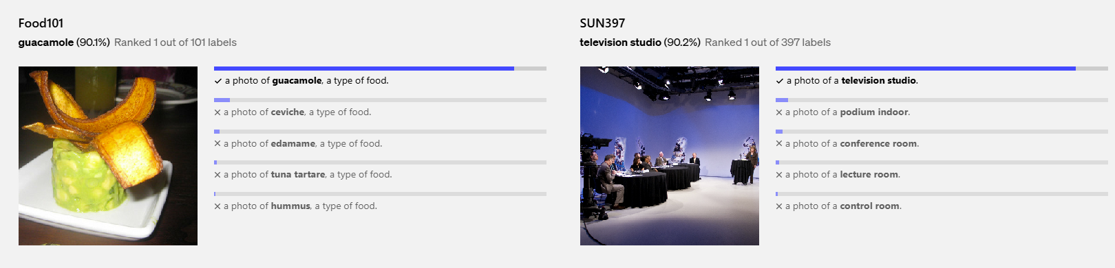
Examples of Predictions of Zero-Shot CLIP Classifiers
https://openai.com/index/clip/

Slide 35
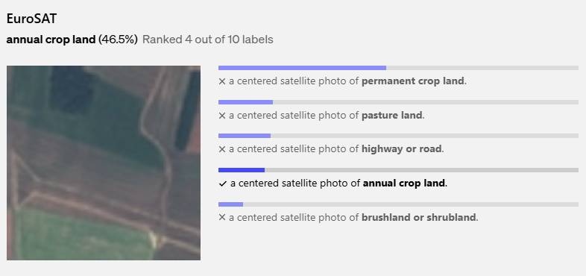
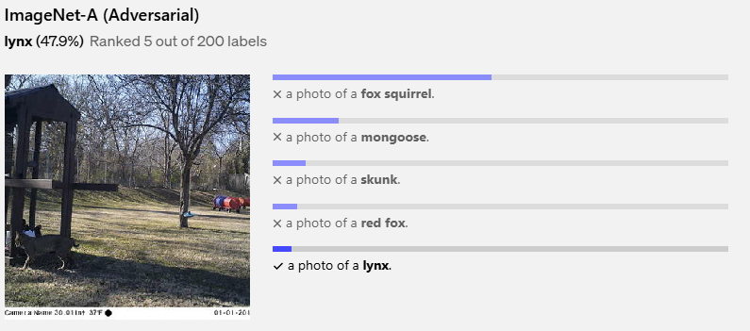
Examples of Predictions of Zero-Shot CLIP Classifiers
https://openai.com/index/clip/

Slide 36
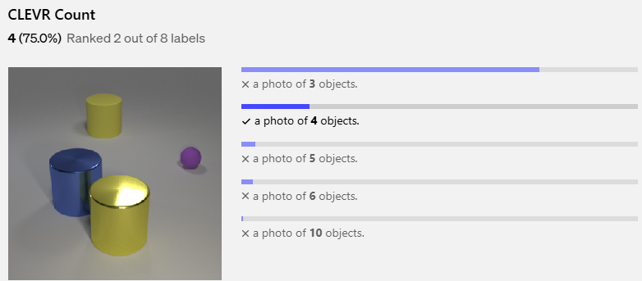
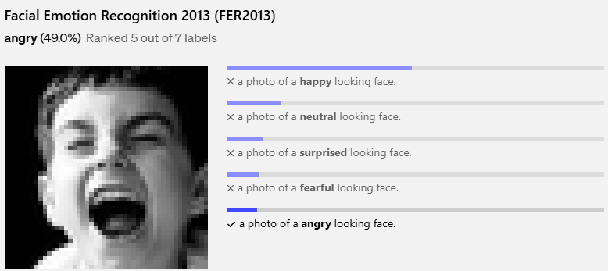
Examples of Predictions of Zero-Shot CLIP Classifiers
https://openai.com/index/clip/

Slide 37
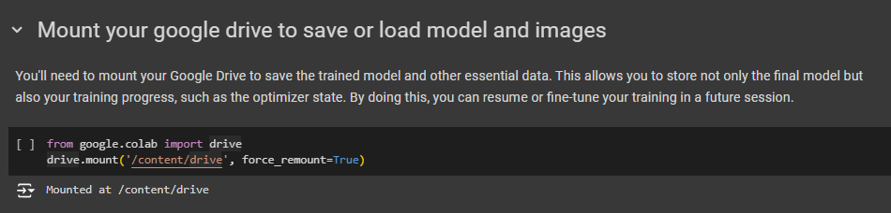
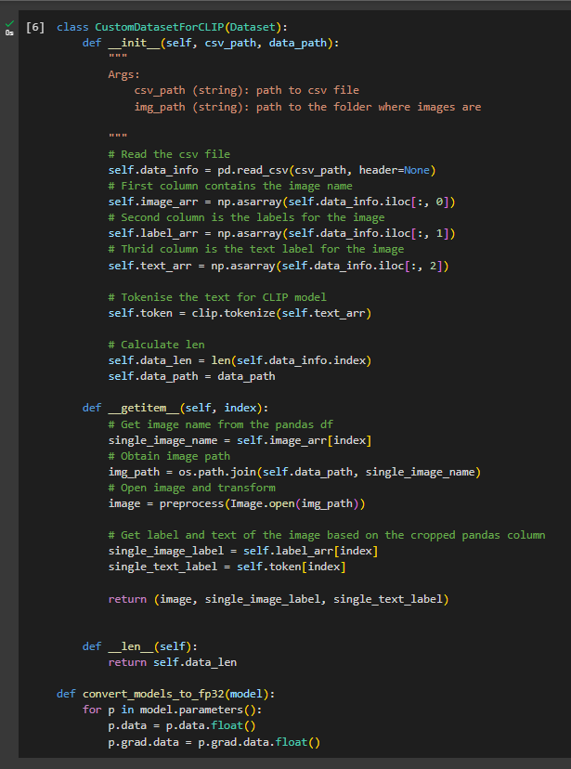
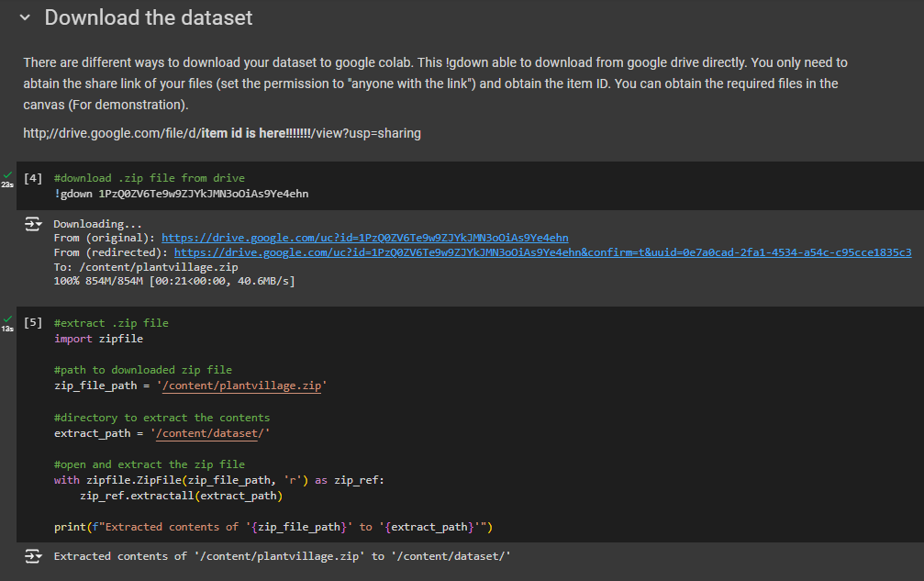
Learning material 3 (CLIP_model_training.ipynb)

Slide 38
Thank You ☺

